Slide 1
Unit 7 Sequential Circuits

Slide 2
Sequential Circuit
The logic circuits whose outputs at any instant of time depend not only on the present inputs but also on past outputs are called sequential circuits.
A sequential circuit consists of a combinational circuit to which storage elements are connected to form a feedback path.
The storage elements are devices capable of storing binary information.
Sequential circuit is slower in operation than combinational circuit.
It may or may not contain clock input.
Examples: Flip flops, Counters etc
Fig.: Block diagram of a sequential circuit

Slide 3
Types of Sequential Logic circuits
2 types:
i. Synchronous sequential circuit
It is a system whose behavior can be defined from the knowledge of its signals at discrete instant of time (i.e., by the clock signal parallelly driven by one clock signal)
The output changes only at specific(discrete) time.
Can be level triggered (HIGH and LOW) or edge triggered(Positive rising and negative falling edge)

Slide 4
Types of Sequential Logic circuits
ii. Asynchronous sequential circuit
It is a system whose behavior depends in the order in which its input signals change .(one’s output is given to clock of another).
The output can change at any time.
Note:
Clock: It is a control signal that periodically makes transition from zero to one (0 to 1) and then back to zero (0).It is usually denoted by CP, Clk.

Slide 5
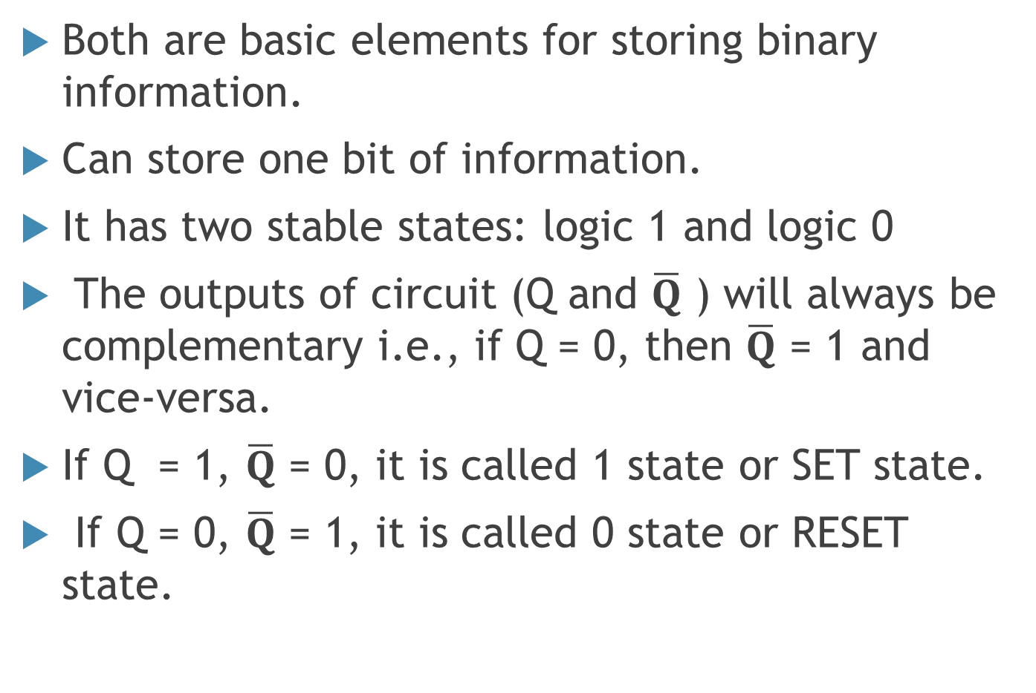
Latch and Flip flops
Both are basic elements for storing binary information.
Can store one bit of information.
It has two stable states: logic 1 and logic 0
The outputs of circuit (Q and $\overline{Q}$ ) will always be complementary i.e., if Q = 0, then $\overline{Q}$ = 1 and vice-versa.
If Q = 1, $\overline{Q}$ = 0, it is called 1 state or SET state.
If Q = 0, $\overline{Q}$ = 1, it is called 0 state or RESET state.

Slide 6
Latch and Flip flops
Flip flop is a sequential circuit that change its output based on present input as well as clock signal.
Examples: SR flipflop, D flipflop etc.
Latch is a sequential circuit that changes its output whenever there is change in input. Clock pulse is not used.
Examples: SR latch, D latch etc.

Slide 7
Types of Flip flops
SR flipflop (Set Reset flipflop)
D flip flop (Delay or Data flipflop)
JK flipflop
T flipflop (Toggle flipflop)
Master slave flipflop

Slide 8
SR latch using NOR gates
Fig: SR Latch using NOR gates
S | R | Qn+1 | Remarks
0 | 0 | Qn | No change
0 | 1 | 0 | Reset
1 | 0 | 1 | Set
1 | 1 | ? | Invalid/ Forbidden
Fig: Truth Table

Slide 9
Gated RS Latch(Level Triggered)
SR latch using control input
Fig.: Logic symbol
Fig.: Gated RS latch
EN | S | R | Qn+1 | Remarks
0 | X | X | Qn | No change
1 | 0 | 0 | Qn | No change
1 | 0 | 1 | 0 | Reset
1 | 1 | 0 | 1 | Set
1 | 1 | 1 | ? | Invalid/ Forbidden
Fig: Truth Table

Slide 10
Timing Diagram
EN
Qn+1

Slide 11
Edge Triggered Flipflop
R
i
s
i
n
g
e
d
g
e
o
r
p
o
s
i
t
i
v
e
t
r
a
n
s
i
t
i
o
n
(
P
T
)
F
a
l
l
i
n
g
e
d
g
e
o
r
N
e
g
a
t
i
v
e
t
r
a
n
s
i
t
i
o
n
(
N
T
)
Edge Triggered RS Flipflop
R
R
Q
Q
CP
CP
Q
S
Q
S

Slide 12
Edge Triggered RS Flipflop
P
R
E
S
S
S
Q
Q
C
P
t
r
P
u
l
s
e
C
P
a
n
s
i
t
i
o
n
d
e
t
e
c
t
o
r
R
Q
R
Q
R
F
i
g
.
:
L
o
g
i
c
d
i
a
g
r
a
m
o
f
R
S
f
l
i
p
f
l
o
p
C
L
R
F
i
g
.
:
L
o
g
i
c
s
y
m
b
o
l
o
f
p
o
s
i
t
i
v
e
e
d
g
e
t
r
i
g
g
e
r
e
d
R
S
f
l
i
p
f
l
o
p
CP | S | R | Q_{n+1} | Remarks
↑ | 0 | 0 | Q_{n} | No change
↑ | 0 | 1 | 0 | Reset
↑ | 1 | 0 | 1 | Set
↑ | 1 | 1 | ? | Invalid
Fig: Truth Table

Slide 13
Characteristics Table and Characteristic Equation
S | R | Q_{n} | Q_{n+1} | Remarks
0 | 0 | 0 | 0 | No change
0 | 0 | 1 | 1 | No change
0 | 1 | 0 | 0 | Reset
0 | 1 | 1 | 0 | Reset
1 | 0 | 0 | 1 | Set
1 | 0 | 1 | 1 | Set
1 | 1 | 0 | X | Invalid
1 | 1 | 1 | X | Invalid
Q
+1 = S + Q
–
n
n
R
This is the characteristic equation
of SR Flipflop

Slide 14
Edge Triggered D Flipflop
Improved version of SR flip flop
Avoids Invalid condition of SR flip flop
P
R
E
R
Q
D
Q
C
P
P
u
l
s
d
e
e
t
r
a
n
s
i
t
i
o
n
C
P
t
e
c
t
o
r
S
Q
Q
D
F
i
g
.
:
L
o
g
i
c
d
i
a
g
r
a
m
o
f
D
f
l
i
p
f
l
o
p
C
L
R
F
i
g
.
:
L
o
g
i
c
s
y
m
b
o
l
o
f
p
o
s
i
t
i
v
e
e
d
g
e
t
r
i
g
g
e
r
e
d
D
f
l
i
p
f
l
o
p
R
Q
CP | D | Q_{n+1} | Remarks
0 | × | Q_{n} | No change
↑ | 0 | 0 | Same as D
↑ | 1 | 1 | Same as D
CP
Q
D
S
Logic diagram of positive edge triggered D flip flop
Truth Table

Slide 15
Characteristics Table and Characteristic Equation
CP | D | Q_{n} | Q_{n + 1} | Remarks
↑ | 0 | 0 | 0 | same as D
↑ | 0 | 1 | 0 | same as D
↑ | 1 | 0 | 1 | same as D
↑ | 1 | 1 | 1 | same as D
Characteristics table of D flip flop
Using K-Map,
Q_{n+1} = D
It is the characteristics equation of D flip flop

Slide 16
Edge triggered JK Flip Flop
Refinement of SR flip flop to solve indeterminate state
Inputs J and K behaves like inputs S and R to set and Reset the flip flop
P
r
e
s
e
t
K
R
Q
J
Q
CP
CP
K
Q
S
Q
J
C
l
e
a
r
F
i
g
.
:
J
K
f
l
i
p
-
f
l
o
p
F
i
g
.
:
L
o
g
i
c
S
y
m
b
o
l

Slide 17
Characteristics Table and Characteristic Equation
CP | J | K | Q_{n} | Q_{n+1} | Remarks
↑ | 0 | 0 | 0 | 0 | No change
↑ | 0 | 0 | 1 | 1 | No Change
↑ | 0 | 1 | 0 | 0 | Reset
↑ | 0 | 1 | 1 | 0 | Reset
↑ | 1 | 0 | 0 | 1 | Set
↑ | 1 | 0 | 1 | 1 | Set
↑ | 1 | 1 | 0 | 1 | Toggle
↑ | 1 | 1 | 1 | 0 | Toggle
Characteristics Table
Using K-Map,
–
–
Q
=
Q
J+ Q
n+1
n
n
K
It is the characteristics equation of JK flip flop

Slide 18
Edge triggered T Flip Flop
It is made by shorting the J and K input of JK flipflop to single input T.
The output toggles each time for T = 1
P
R
E
T
T
Q
K
C
P
Q
Q
CP
J
Q
C
L
R
F
i
g
.
:
L
o
g
i
c
s
y
m
b
o
l
o
f
n
e
g
a
t
i
v
e
e
d
g
e
t
r
i
g
g
e
r
e
d
T
f
l
i
p
f
l
o
p
F
i
g
.
:
L
o
g
i
c
d
i
a
g
r
a
m

Slide 19
Characteristics Table and Characteristic Equation
CP | T | Q_{n} | Q_{n+1} | Remarks
 | 0 | 0 | 0 | No change
 | 0 | 1 | 1 | No change
 | 1 | 0 | 1 | Toggle
 | 1 | 1 | 0 | Toggle
Using K- Map,
Q
=
–
–
n+1
Q
n
T + Q
T
n
= (Q
⊕
T)
n
This is the characteristic equation of T flip flop

Slide 20
Flipflop excitation table
Transition |  | RS flipflop |  | JK flipflop |  | D flipflop | T flipflop
Q_{n} Q_{n+1} |  | S | R | J | K | D | T
0 | 0 | 0 | × | 0 | × | 0 | 0
0 | 1 | 1 | 0 | 1 | × | 1 | 1
1 | 0 | 0 | 1 | × | 1 | 0 | 1
1 | 1 | × | 0 | × | 0 | 1 | 0
Excitation table of flipflops

Slide 21
Flip flop conversion numerical
Convert SR flipflop to JK flipflop
Step 1:
First we generate the truth table for JK flip–flop i.e., note Q_{n} → Q_{n+1} transition for a given combination of JK input.
Step 2:
Next on the same table for Q_{n} → Q_{n+1} transition identify the excitation table for SR flip–flop such tables are known as synthesis table.

Slide 22
J_{n} | K_{n} | Q_{n} | Q_{n+1} | S_{n} | R_{n}
0 | 0 | 0 | 0 | 0 | ×
0 | 0 | 1 | 1 | × | 0
0 | 1 | 0 | 0 | 0 | ×
0 | 1 | 1 | 0 | 0 | 1
1 | 0 | 0 | 1 | 1 | 0
1 | 0 | 1 | 1 | × | 0
1 | 1 | 0 | 1 | 1 | 0
1 | 1 | 1 | 0 | 0 | 1
Using K-Map,
⎯
S
= J
Q
n
n
n

Slide 23
Fig.: JK flipflop using SR flipflop

Slide 24
Master Slave Flipflop
Race Around Condition
In JK flipflop, if the duration of clock pulse is greater than delay between input and output, the output may come back as the input to the flipflop and may result indeterminate outputs within the same clock pulse (instead of a single state output).
This problem is known as “race around condition” in JK flip flop.
Master slave flipflop is required to remove the race around condition.
It consists of two flipflops; one serve as master and another as slave. Master is positive edge triggered and slave is negative edge triggered.

Slide 25
Master Slave Flip flop
Fig: Logic diagram of master slave JK flipflop
Operation:
When CP=1, the slave is isolated and Master is enabled.
When CP=1, the information is passed from the Master Flipflop to the Slave and Output is obtained.

Slide 26
Sequential circuit design procedure
2) Draw the state transition diagram from given specification.
3) Draw the next state table from the given information.
4) The number of states may be reduced by state reduction method if necessary.
5) Assign the states with binary value.
6) Determine the type and number of flipflops to be used and derive the excitation table based on present state (Q_{n}) to next state (Q_{n+1}) transition and output table.
7) Using K-map, simplify each input of flipflop and circuit output.
8) Draw the logic diagram.

Slide 27
State Reduction Technique
Two states are equivalent if they have same next state and output conditions.
If they are equivalent, one of them is redundant i.e., can be eliminated or replaced.
0
/
0
1
/
1
a
1
0
/
0
/
0
f
1
/
1
0
/
0
b
0
/
0
1
/
0
d
1
/
0
0
/
0
1
c
/
0
e
0
/
0

Slide 28
Present State | Next State |  | Present Output
 | X = 0 | X = 1 | X = 0 | X = 1
a | a | b | 0 | 0
b | c | d | 0 | 0
c | e | f | 0 | 0
d | b | a | 0 | 1
e | c | d | 0 | 0
f | b | a | 0 | 1

Slide 29
Present State | Next State |  | Present Output
 | X = 0 | X = 1 | X = 0 | X = 1
a | a | b | 0 | 0
b | c | d | 0 | 0
c | b | d | 0 | 0
d | b | a | 0 | 1
State Reduction table

Slide 30
Numerical related to sequential circuit

Slide 31
End of Unit 7

